Slide 1
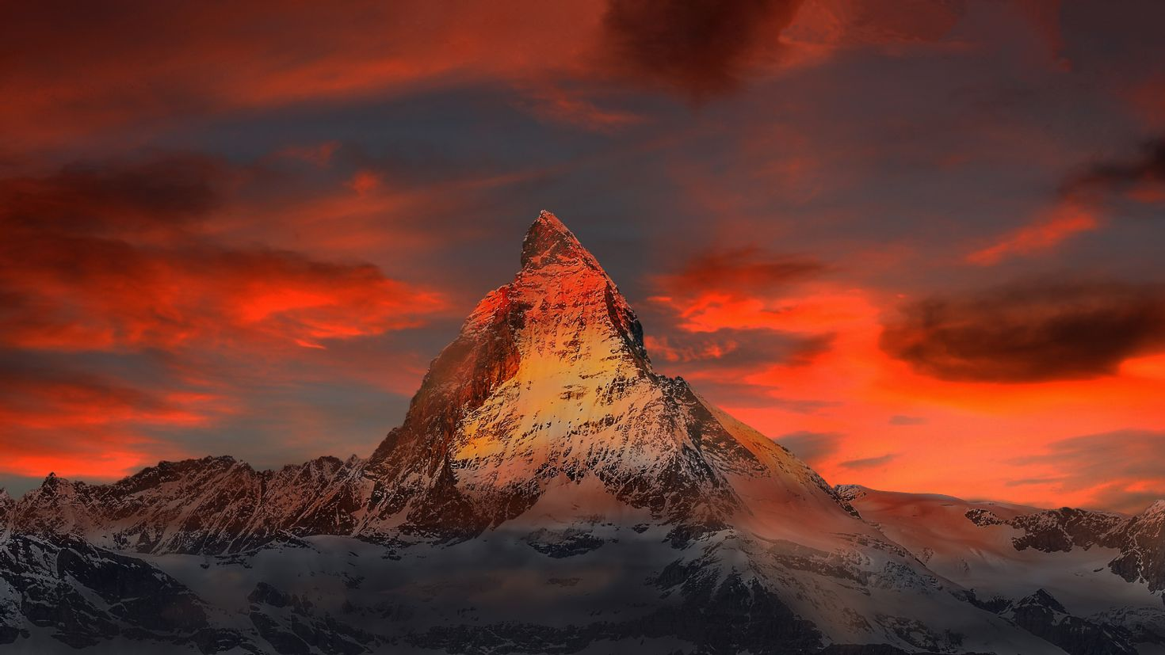
I Exalt Thee

Slide 2
D A G A D A
I exalt Thee, I exalt Thee, I exalt Thee, O Lord
D A G A D A
I exalt Thee, I exalt Thee, I exalt Thee, O Lord
1 of 2

Slide 3
D A G A D A
I exalt Thee, I exalt Thee, I exalt Thee, O Lord
D A G A D
I exalt Thee, I exalt Thee, I exalt Thee, O Lord
2 of 2

Slide 4
D Em A D Bm
For Thou, O Lord, art high above all the earth
Em A D
Thou art exalted far above all gods
D Em A D Bm
For Thou, O Lord, art high above all the earth
Em A D
Thou art exalted far above all gods

Slide 5
D A G A D A
I exalt Thee, I exalt Thee, I exalt Thee, O Lord
D A G A D A
I exalt Thee, I exalt Thee, I exalt Thee, O Lord
1 of 2

Slide 6
D A G A D A
I exalt Thee, I exalt Thee, I exalt Thee, O Lord
D A G A D
I exalt Thee, I exalt Thee, I exalt Thee, O Lord
2 of 2 & END

